Slide 1
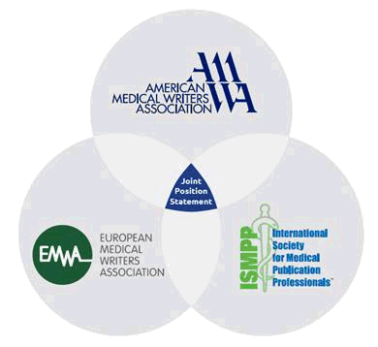
AMWA – EMWA – ISMPP
Joint Position Statement on
Predatory Publishing

Slide 2

Background: Exploding numbers of open access (OA) journals, including predatory journals
Predatory journals and publishers undermine the quality, integrity and reliability of scientific research
Predatory publishers exploit the Gold OA model (pay to publish) solely for financial gain. They misrepresent ethics in editorial and peer review, journal operation, article processing charges, dissemination, indexing and archiving.

Slide 3
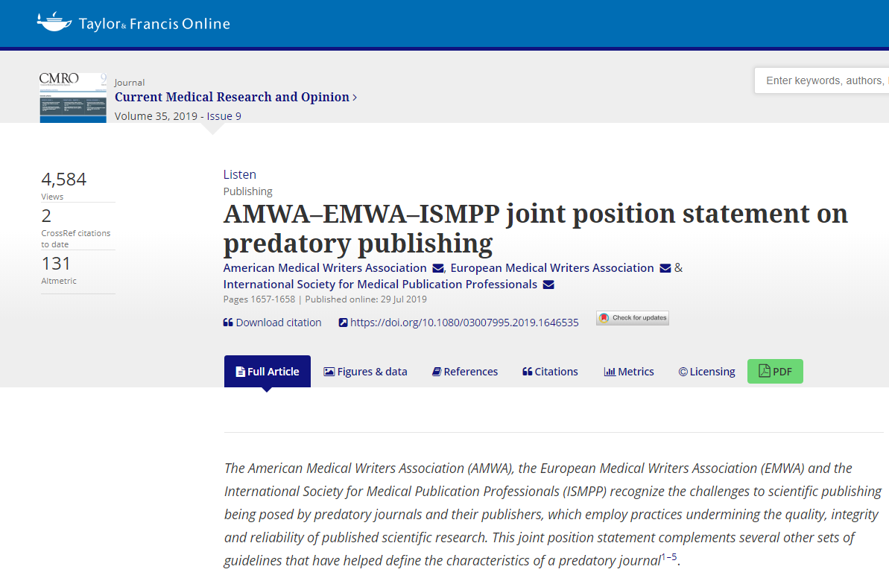
American Medical Writers Association,
European Medical Writers Association
& International Society for Medical Publication Professionals (2019)
AMWA–EMWA–ISMPP joint position statement on predatory publishing.
Current Medical Research and Opinion
DOI: 10.1080/03007995.2019.1646535

Slide 4
Growth of OA predatory publishers
Stand alone journals
Year | No.
2013 | 126
2014 | 303
2015 | 507
2017 | 1294
2019 | 10,000
Notes:
Need to get references

Slide 5
Short list of predatory characteristics
Business practices | Editorial and peer review | Publication practices
Aggressive email solicitation | Subverted peer review (e.g., overly quick, absent) | Misleading metrics
Article processing charges often not transparent | Questionable expertise or fictional editorial board | False claims of impact factor or indexing
Journal name, format or logo deviously mimics legitimate ones | Overly simple submission (e.g., no COI or authorship qualifications) | Lack of digital preservation
Publisher has large fleet of many specialties or journals, may have few published articles | Lack of information on editorial/review board | Do not adhere to good publication practices by WAME, COPE, ICJME or CSE
Website suspicious: no or fake address, possible low quality | Author can’t un-submit from predatory journals

Slide 6
AMWA – EMWA – ISMPP working group
Convened January 2019, members included:
Association | Staff liaison | Subject matter experts
EMWA | Tiziana von Bruchhausen/ Beatrix Doerr | Slávka Baróniková Julia Donnelly
AMWA | Shari Rager | Barbara Good Mary Kemper
ISMPP | Al Weigel | Jan Seal-Roberts Donna Simcoe

Slide 7
Aims of joint position statement
Medical writers/editors and researchers have responsibility to evaluate the integrity, history, practices, and reputation of journal
Conscious and deliberate submission to a predatory journal is unethical
AMWA, EMWA, and ISMPP are committed to educating our members about predatory publishing

Slide 8
Avoid predatory publishers and journals
Adhere to good publication practices, e.g., COPE, WAME?
Is journal in Directory of Open Access?
Indexing verified?
e.g., PubMedCentral
Journal following best practices? Transparent?
✔Editor in charge credible with contact information?
✔Information on APCs clear?
✔Impact factor verified?
e.g., J Citation Reports
✔Checked online lists and resources? Journal evaluation tool?

Slide 9
On-going and next… a collaborative effort
Link to CMRO and follow on Twitter
AMWA: Nov-2019 conference, December journal
EMWA: Nov-2019 conference, print statement in MEW, September 2019
ISMPP: Aug MAPP newsletter, 9/6 meeting and West conference
Joint press release July 2019
Endorsement by other societies
Translation
Slide deck
EMWA ambassador program
Other suggestions?

