Slide 1
PAVING THE WAY: EMWA’s leadership in raising medical communications standards
February 2016

Slide 2
EMWA is an association committed to representing, supporting, and training medical communication professionals

Slide 3
Foundation
EMWA was founded in 1992 as a chapter of the American Medical Writers Association (AMWA); 32 people from 7 countries attended the inaugural meeting in Brussels
The first conference to include a programme of workshops was held in Bruges in 1995
EMWA became independent from AMWA in 1997

Slide 4
Recent Key Initiatives
2013: Symposium Day
2014: CORE Reference Project – Clarity and Openness in Reporting: E3-based
2015: Expert Seminar Series (ESS)
2015: Pharmacovigilance Special Interest Group (PV SIG)
2016: Regulatory Public Disclosure Special Interest Group (RPD SIG)

Slide 5
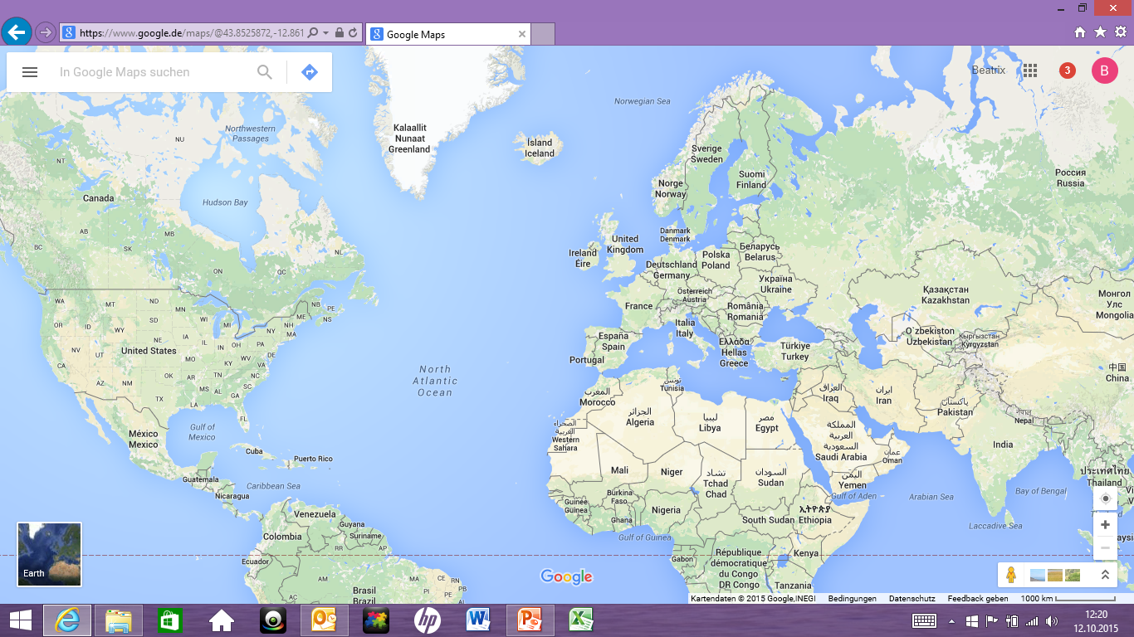
Membership
> 1000 members
> 40 countries
> 12 countries
outside Europe

Slide 6
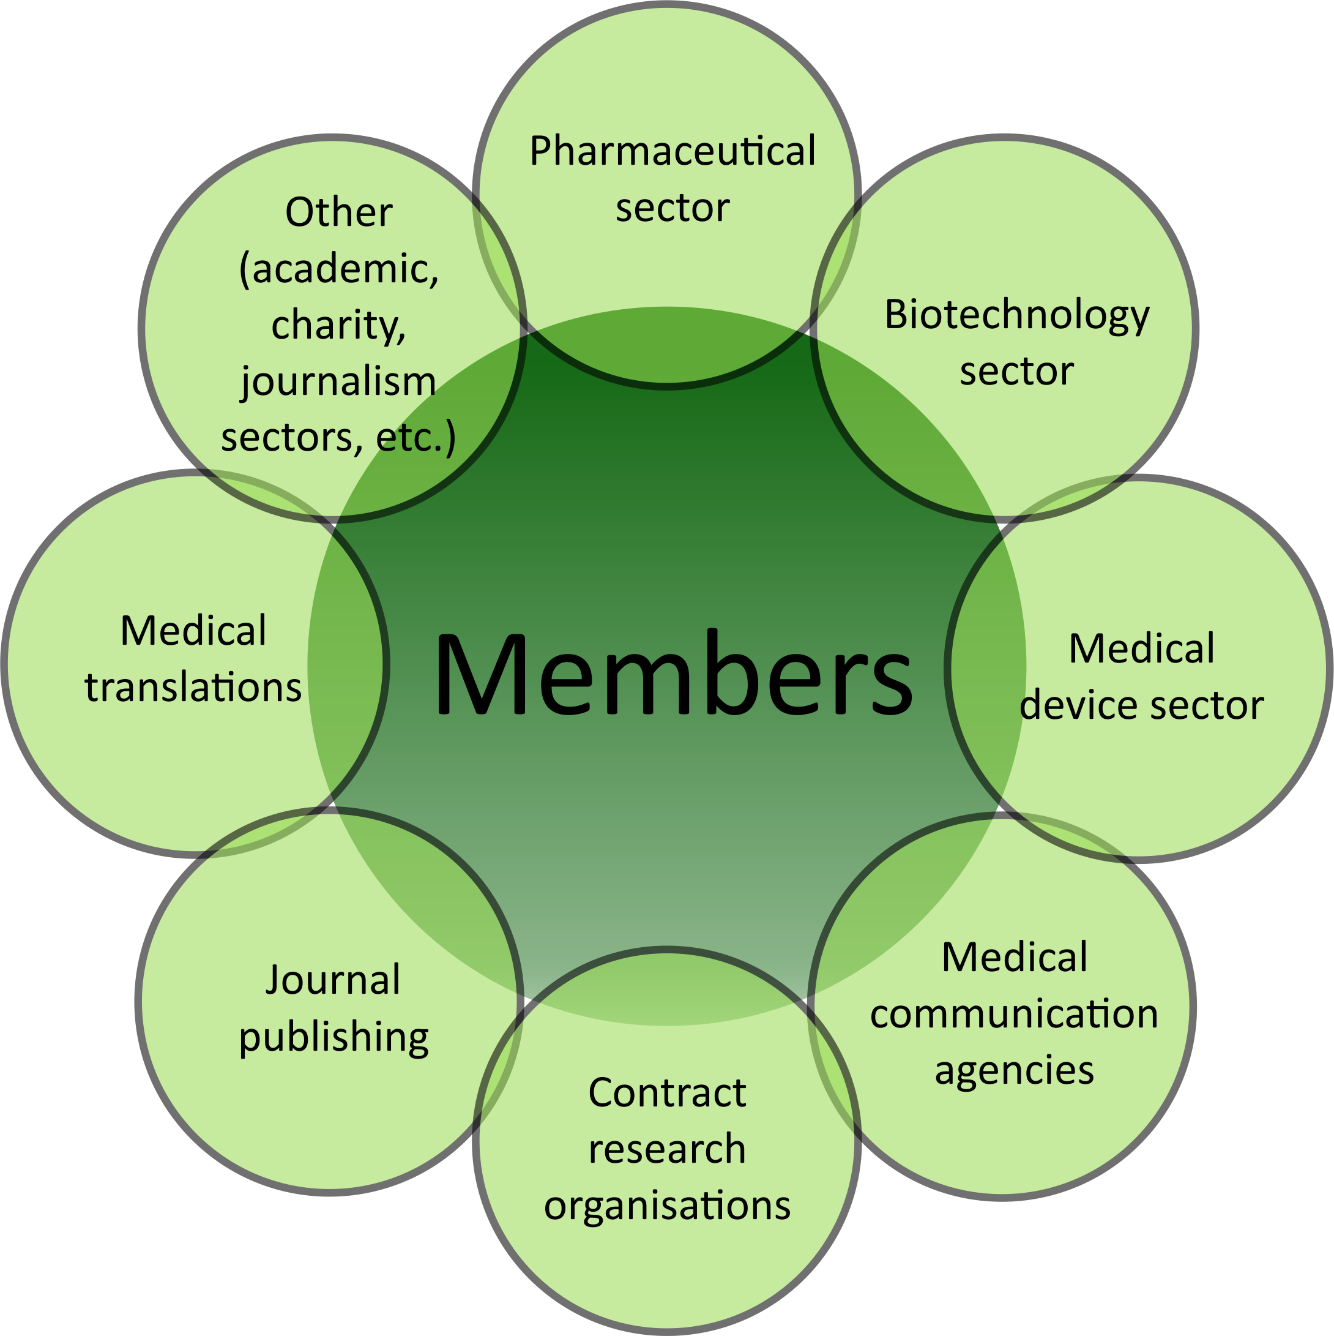
Members (Salaried and Freelance)

Slide 7
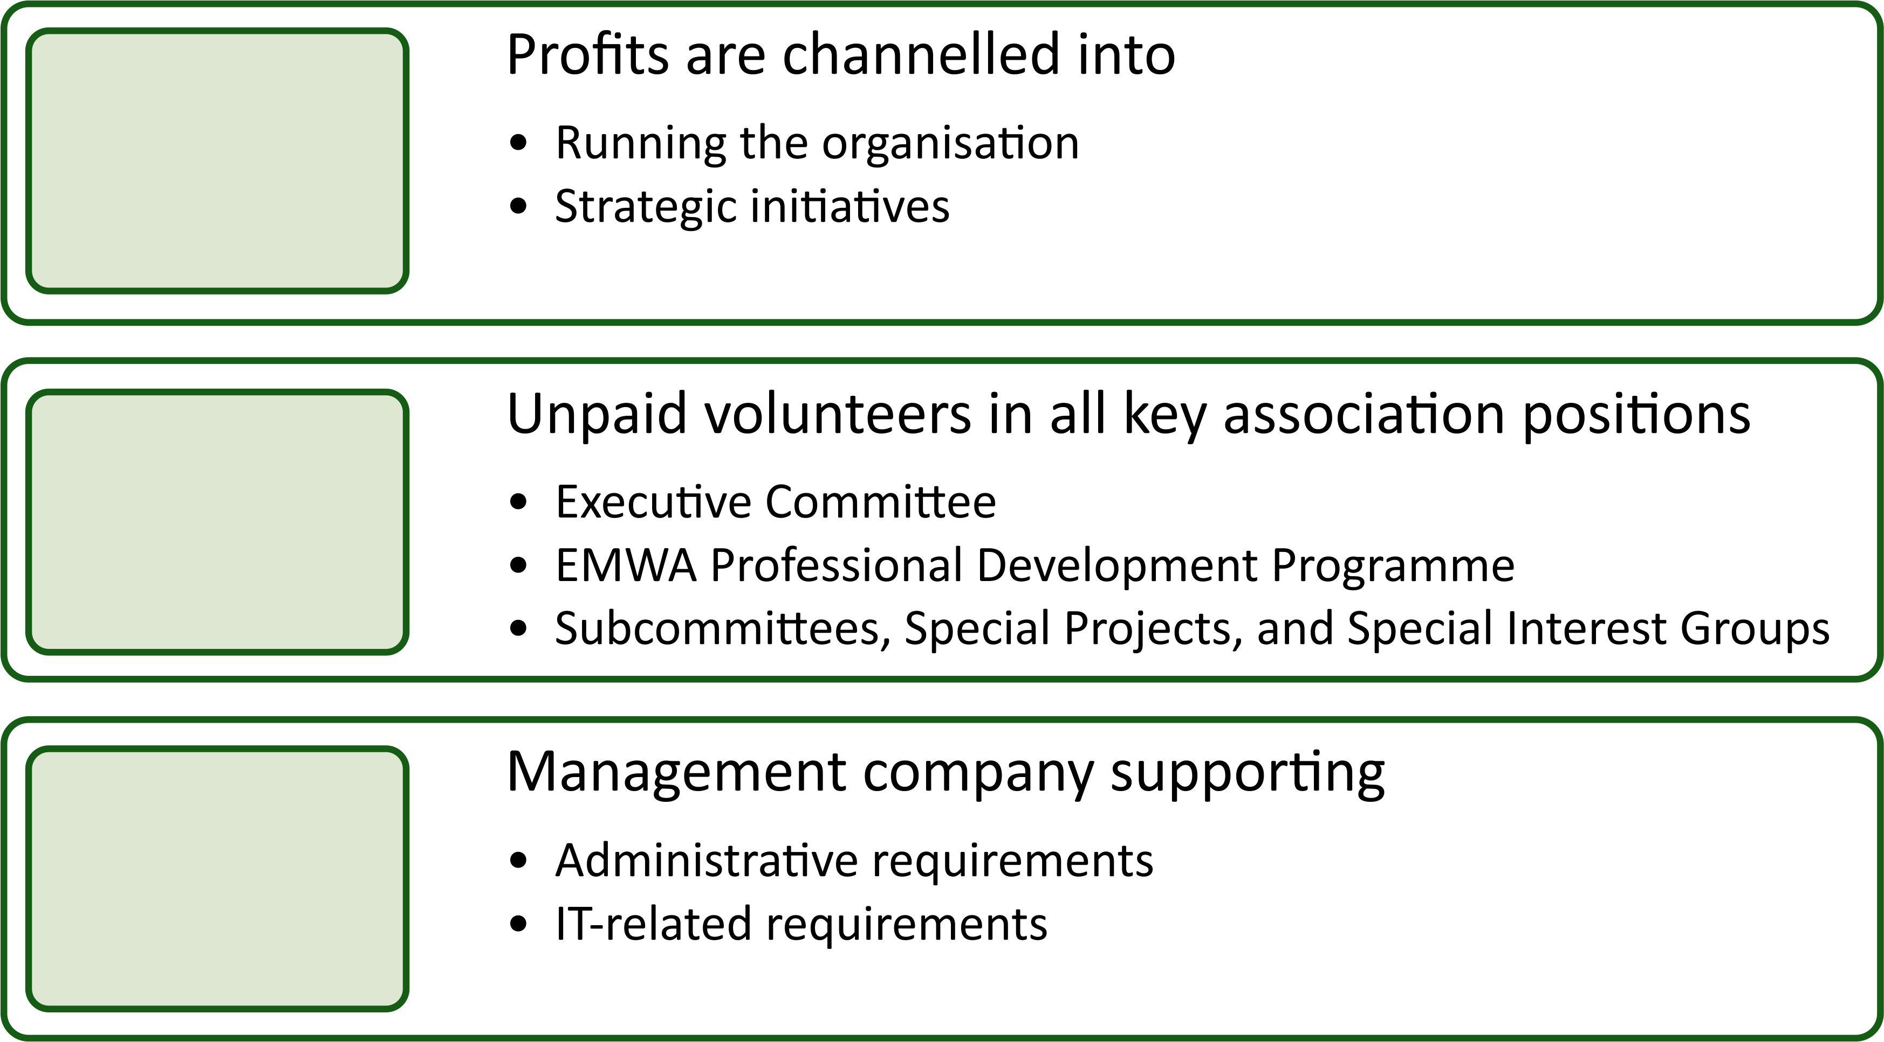
Structure
Not-for-profit and independent
Driven by members for members
Supported by professional Head Office

Slide 8
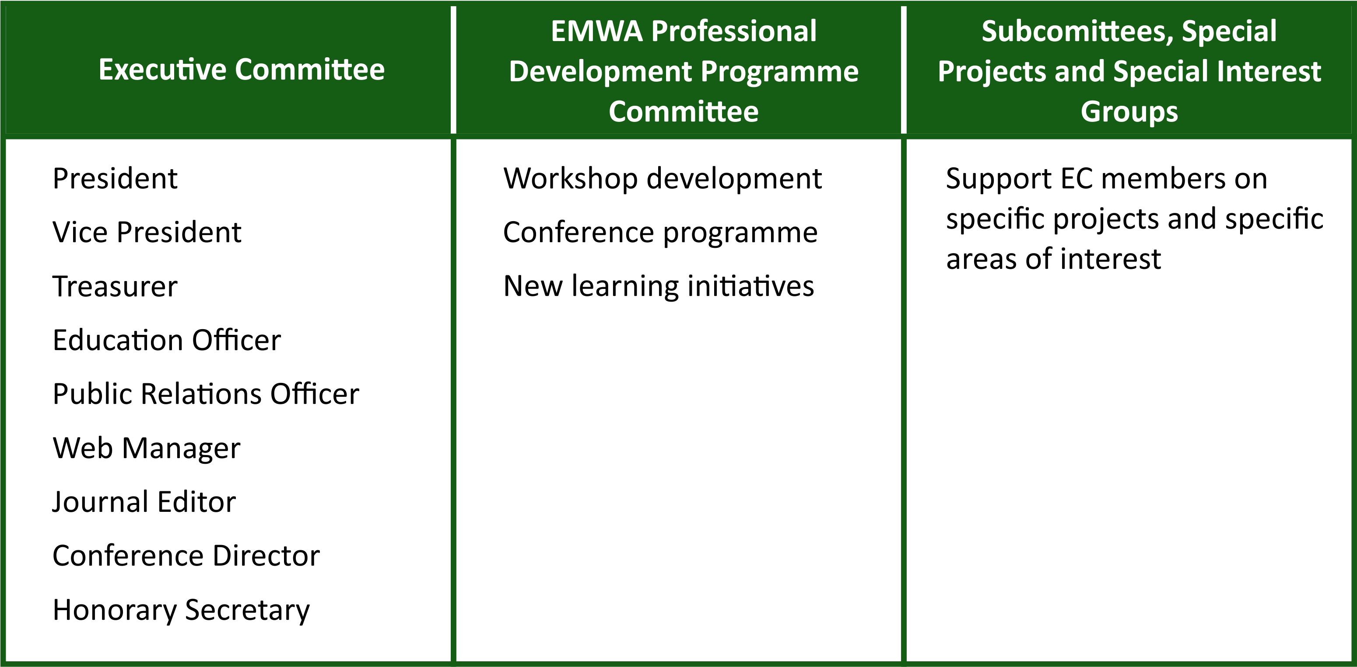
Volunteer Member Roles

Slide 9
Key Aims
Further our profession
Grow the Association and membership
Share expertise
Maintain governance
Provide value for money

Slide 10
EMWA Membership Provides
Bi-annual conferences held throughout Europe
Professional Development Programme at foundation and advanced levels, with opportunity to gain certificates
Introduction to emerging and developing areas through annual Symposium Days
Extended learning opportunities for experienced members through Expert Seminar Series (ESS) and Special Interest Groups (SIGs)
Webinars on topics of interest
Networking opportunities
Opportunities to further the profession of Medical Writers/Communicators
Quarterly print issue of Medical Writing Journal
Access to Membership Only section of the EMWA website
Discounts on books, insurance, software, etc.
Freelance Benefits Package

Slide 11
Conferences
Selection of half-day workshops
Provide training in a wide range of topics at foundation and advanced levels, with an opportunity to gain certificates via the Professional Development Programme
Expert Seminar Series
Focuses on the latest developments affecting the medical writing industry and is aimed at experienced medical writers and heads of medical writing departments
Annual Symposium Day
Focuses on emerging and developing areas
Special Interest Group meetings
Freelance Business Forum
Internship Forum
Networking opportunities

Slide 12
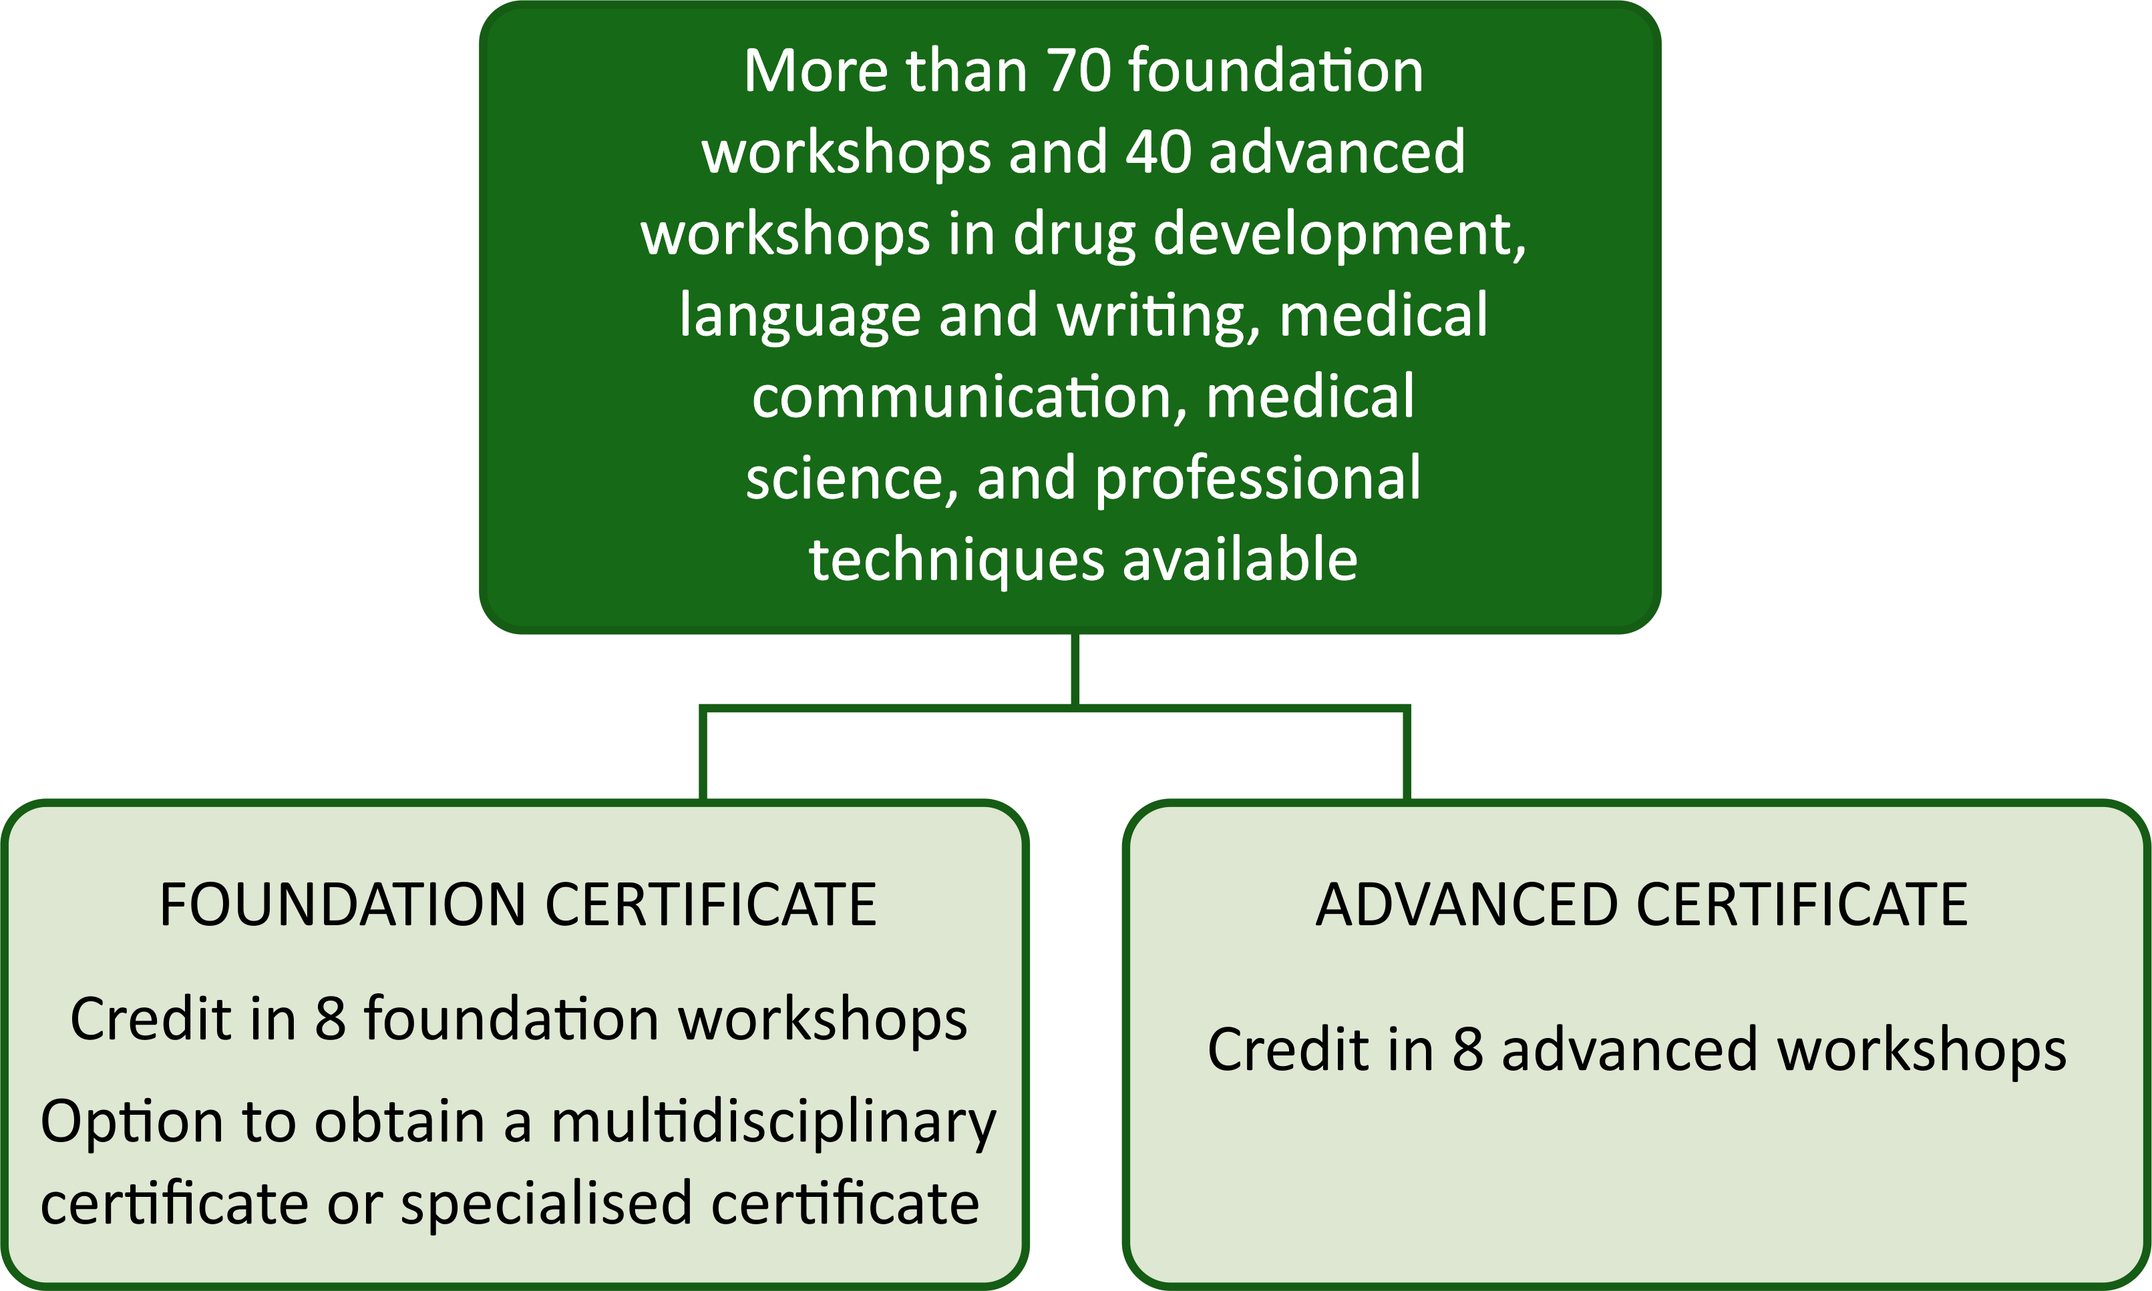
Professional Development Programme

Slide 13
Webinars
10 webinars per year
Cover areas of interest for new and experienced medical communicators
From “introduction to medical writing” to “effective project management and communication”
Practical training on how to write medical documents
Updates on the latest guidelines
Run by experts in their fields
Approximately 1 hour per webinar
Opportunity to raise questions
Webinar archive covering all webinars since January 2015 available on the website

Slide 14
Networking Opportunities
At Conferences
Workshops, symposia, and seminars Social events Welcome reception Conference dinner City tours Lunchtime roundtables For freelancers Freelance Business Forum Freelance Information Point
Via the Website and Other Channels
Discussion forums Company listing Partnership and advertising opportunities Volunteering opportunities EMWA’s LinkedIn Twitter Facebook Freelance listing Freelance Resource Centre

Slide 15
EMWA’s Involvement in Industry
Furthering the profession of medical communicators
Sharing best practice
Developing resources such as CORE (Clarity and Openness in Reporting: E3-based) Reference
Pharmacovigilance Special Interest Group to address medical writing issues specifically related to drug safety and pharmacovigilance
Regulatory Public Disclosure Special Interest Group to focus on public disclosure of regulatory documents

Slide 16
Medical Writing Journal
4 print issues per year
Online archive
Wide range of topics relevant to medical writing
Feature articles (open access)
Medical writing and regulatory news and updates
Freelance section
Reviews of relevant books and websites
Wide variety of regular columns for medical writers

Slide 17
EMWA’s Website: www.emwa.org
Comprehensive Resource
EMWA profile and position statements News Training (EDPD and webinars) Online journal Jobs Company listings Freelance directory Resources for freelancers Conferences Members’ Only section Special Interest Groups
Conference Registration
Online registration system Download workshop assignments Online conference planner Workshop profiles and leaders’ biopics Travel and accommodation recommendations Social program information and bookings Academic record available at a glance

Slide 18
Other EMWA Benefits
Discounts on literature-referencing software and literature-review software
Discounts on insurances
Discounts on books
Freelance benefits package
Freelance directory listing
15% discount on IPSE membership: https://www.ipse.co.uk/

Slide 19
Join Our Network
If you want further information about EMWA or medical writing, or would like to become a member, please go to our website at www.emwa.org or contact our head office at
EMWA Head Office
Chester House, 68 Chestergate, Macclesfield,Cheshire SK11 6DY
Tel: +44 (0) 1625 664534
E-mail: info@emwa.org

